Slide 2
React Native workshop
Shlomi Cohen & Amit Bezalel
CHC Jacksonville Dev Con
Feb 2020

Slide 3
4: Experimentation Workshop
Experimentation
DevCon 2020 Labs Overview
3: React Native Workshop
React Native App
CIAM
2: Apigee Workshop
Apigee Proxy
1: CI/CD Workshop
Service on AWS Fargate
(Automated Infrastructure creation and CI/CD service deployment)
0: HDC Environment
SAL Service
HDC

Slide 4
Agenda
Motivation & Overview of React Native
Your first RN application
Building an app over CHC platform services
Q & A

Slide 5

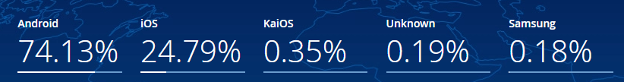
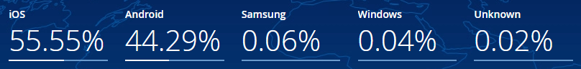

Motivation
Smartphone market share is split:
Global
USA
We must have both Android and iOS apps

Slide 6

Writing a native app
Native?
Hybrid?
Better make that two apps:
Double the work (Android / iOS)
Different Skillsets
Often not cost effective
On the flip side:
Best for performance
Best phone HW integration

Slide 7
Going for Web Hybrid?
Native?
Hybrid?
Yeah!
One application to dev
We are just building an IT app …
Common HTML/JS skillset
Basic sensors are enough
Web Hybrids are:
Slow
Have UI Glitches
Non-native experience (bounce, pull refresh, Look & Feel)
No special sensors (or sensor fusion)
Notes:
Frameworks (web view hybrid):
Cordova
PhoneGap
Ionic
Framework 7

Slide 8

Is React Native different?
A new Hybrid approach:
Write one app
No WebView
Skillset: Mostly JS
Compiles apps per-platform
Full access to native modules
Native UI

Slide 9
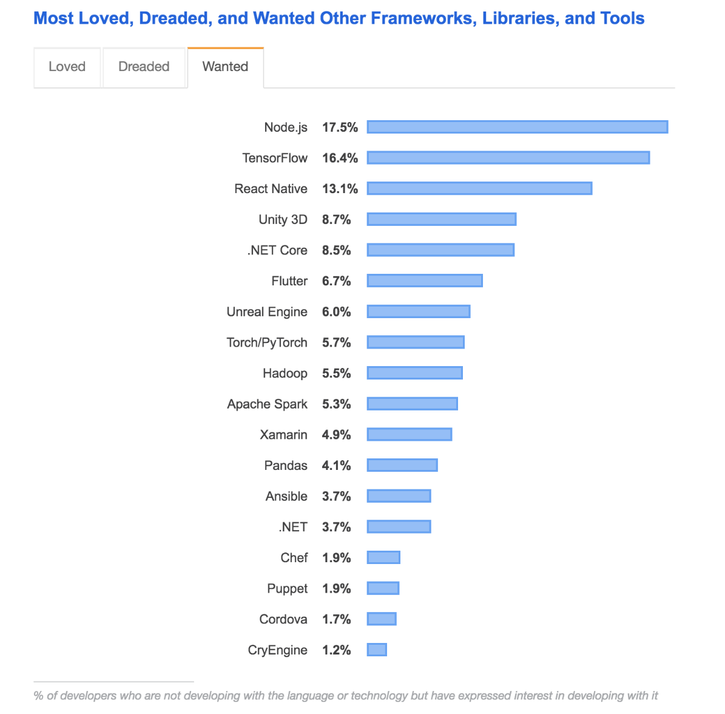

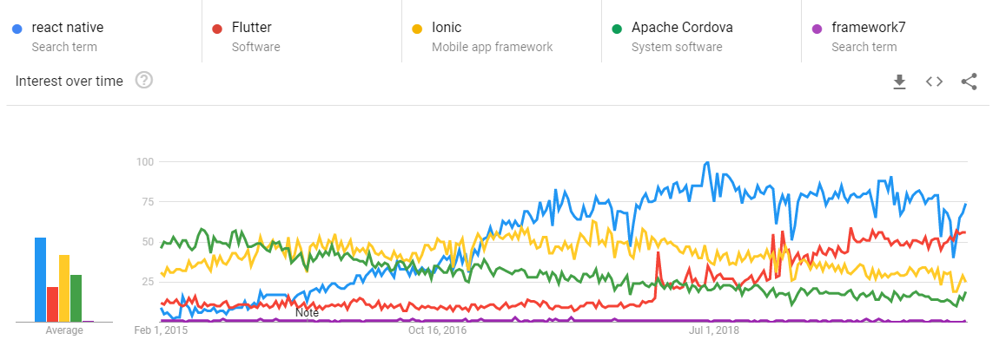
React Native, Is it popular?
Notes:
Frameworks (web view hybrid):
Cordova
PhoneGap
Ionic
Framework 7

Slide 10

Under the hood
JS sends JSON tasks
Native is decoupled from JS
The bridge:
Holds UI outline
Hosts module code
Acts as middleman
~React
JS Engine
Tasks (async)
Bridge
Shadow UI tree
RN Modules
Native
UI Components
Native modules
*RN Architecture is changing, but the basics stay the same.

Slide 11
React Native Pros & Cons
Native
&
Hybrid
Good performance
One app in JavaScript
Access to OS and sensors
Native UI and experience
Community modules
Native DevOps: Compiles native projects
Some native coding for special cases
Some zombie modules in the community

Slide 12
Summary
React native:
A performant hybrid approach
Native UI driven by JS code
App Development estimations:
Method: | Work:
Web Hybrid | 100%
Native | 200%
React Native | 125%

Slide 13
DIY React Native App
download slides:
http://bit.ly/reactnative2020

Slide 14
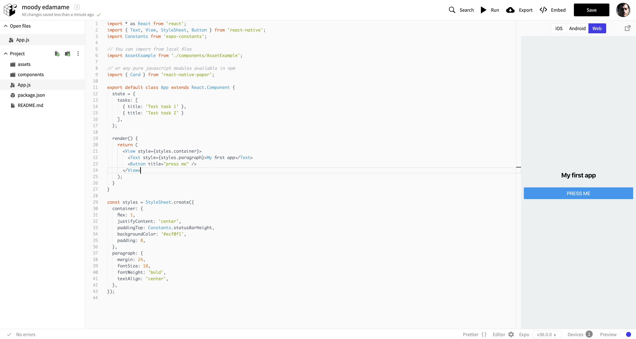
The Expo Online Editor
Navigate to: snack.expo.io
Files
Code Editor
Running App

Slide 15
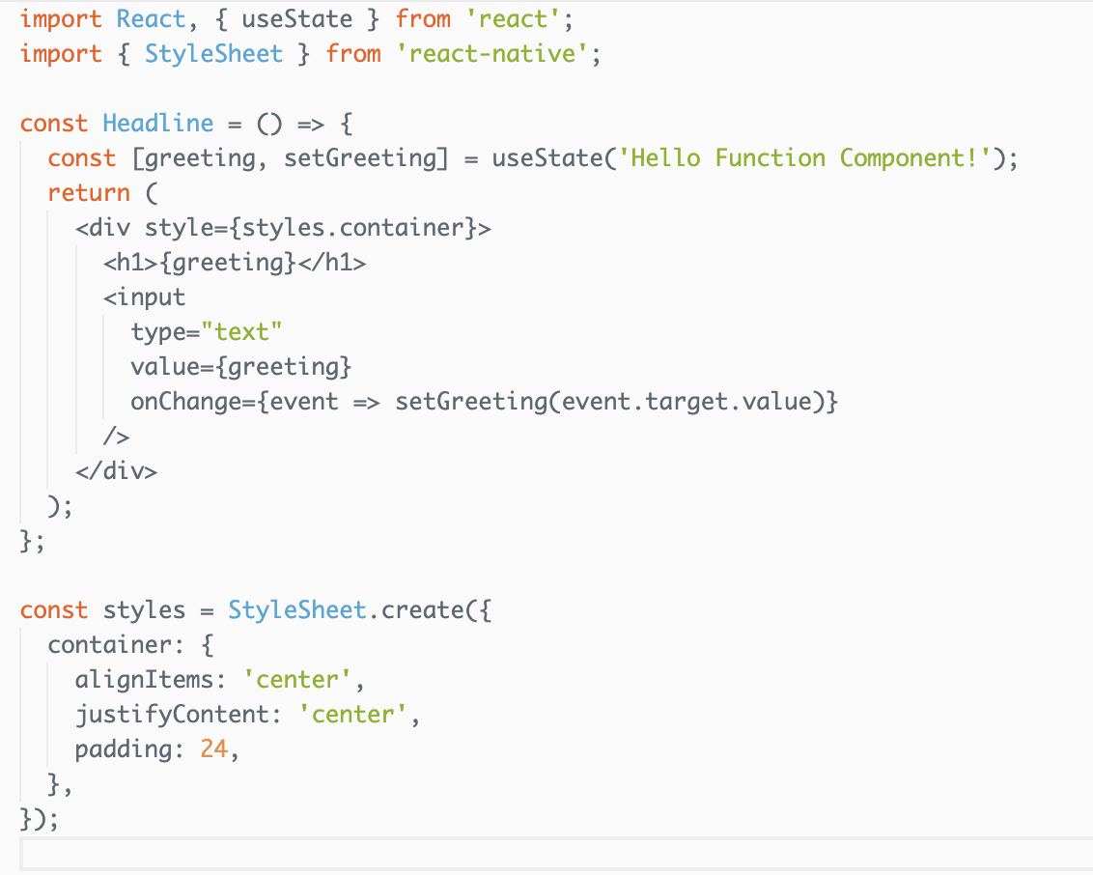
React Native Components
Class Component
Function Component
Class comps extend React.Component
They have state
Imports
Imports
Render function
Function comps are simple & stateless
They hold graphics
State
Render function
Styles
Styles

Slide 16
DIY React Native App
Let’s replace the default code…
Add Some Text:
Remove initial <text> and <card> tags
Under <view style= …> add:
Tip To format code:
Mac Option + Shift + F
Win Ctrl + Shift + F
<Text style={{fontSize: 15, fontWeight: 'bold'}}>Welcome to the ReactNative Workshop!</Text>
<Text>Todo List:</Text>

Slide 17
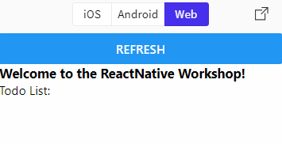
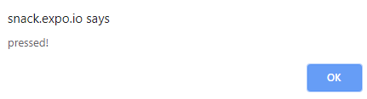
DIY React Native App
Add a button:
import { Text, View, StyleSheet, Button } from 'react-native';
Above the text line, add: <Button title="refresh"/>
See the button appear
Add onPress event handler:
After title="refresh" add: onPress={()=>{alert ("pressed!");}}
Press button to see alert:

Slide 18
DIY React Native App
Add initial state:
Inside the App class add:
state = {
tasks: [
{
title: 'Test task 1',
id: '05dafc66-bd91-43a0-a752-4dc40f039144',
done: true,
},
{
title: 'Test task 2',
id: '05dafc66-bd91-43a0-a752-4dc40f039154',
done: false,
},
],
};

Slide 19
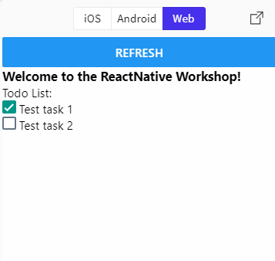
DIY React Native App
import { Text, View, StyleSheet, Button, FlatList , CheckBox } from 'react-native’;
Add list: (after <Text>)
<FlatList
key="flatlist"
data={this.state.tasks}
style={styles.list}
keyExtractor={item => item.id}
renderItem={({ item, separators }) => (
<View style={styles.card}>
<View>
<View style={{flex: 1, flexDirection: 'row'}}>
<CheckBox value={item.done}/>
<Text> {item.title}</Text>
</View>
</View>
</View>
)}
/>

Slide 20
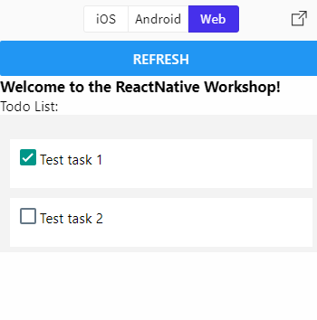
DIY React Native App
Add styles: (overwrite existing)
const styles = StyleSheet.create({
list: {
paddingTop: 20,
backgroundColor: '#F3F3F3',
},
container: {
flex: 1,
justifyContent: 'center',
paddingTop: Constants.statusBarHeight
},
card: {
backgroundColor: '#fff',
flexDirection: 'row',
padding: 10,
paddingTop: 10,
paddingBottom: 20,
margin: 10,
marginTop: 5,
marginBottom: 5,
},
});

Slide 21
DIY React Native App
Change onPress to get new data:
Instead of previous onPress
Press the button to see the real todo list…
onPress={() => {
fetch(
'https://raw.githubusercontent.com/amitbet/fruits/master/chc-tasks.json'
)
.then(response => response.json())
.then(responseJson => {
this.setState({
tasks: [],
});
this.setState({
tasks: responseJson.Tasks,
});
});
}}

Slide 22


Congratulations! You have just created your first RN app

Slide 23
Mobile Authentication

Slide 24

CHC Mobile Authentication
OIDC Authentication against CIAM
Tokens are verified in Apigee
No anonymous access to services
This is a simplified flow:
Apigee
(verify tkn)
Service 1
2. Req + Token
3. Req
Service 2
Res
Res
1. Credentials
CIAM
Identity Provider
CHC
Health App 360
Token

Slide 25
Actual PKCE auth flow
OIDC is based on OAuth 2.0 Authorization Code
PKCE is an OpenID Connect flow
PKCE is meant for mobile apps (no server)
Additional step for Apigee token in production (not shown)
Apigee
(verify tkn)
Service 1
5. Req + Token
Res
6. Req
Service 2
Res
3. Redirect to app
4. key + Code
Token
CIAM
Identity Provider
Mobile App
2. Creds + hash(key)
Code & redirect
1. browser:
get login form

Slide 26
Connecting to CHC Services
Download Slides:
http://Bit.ly/reactnative2020

Slide 27
CHC Mobile tester
CHC tester app:
Authenticates
Pulls user information from Apigee endpoint
Auth:
Don’t keep secrets in client code
Any Apigee secret should be safe on server
Apigee
(verify token)
2. Req + Token
Res
3. Req
User Info
Res
1. Credentials
CIAM
Identity Provider
CHC
Test App
Token

Slide 28
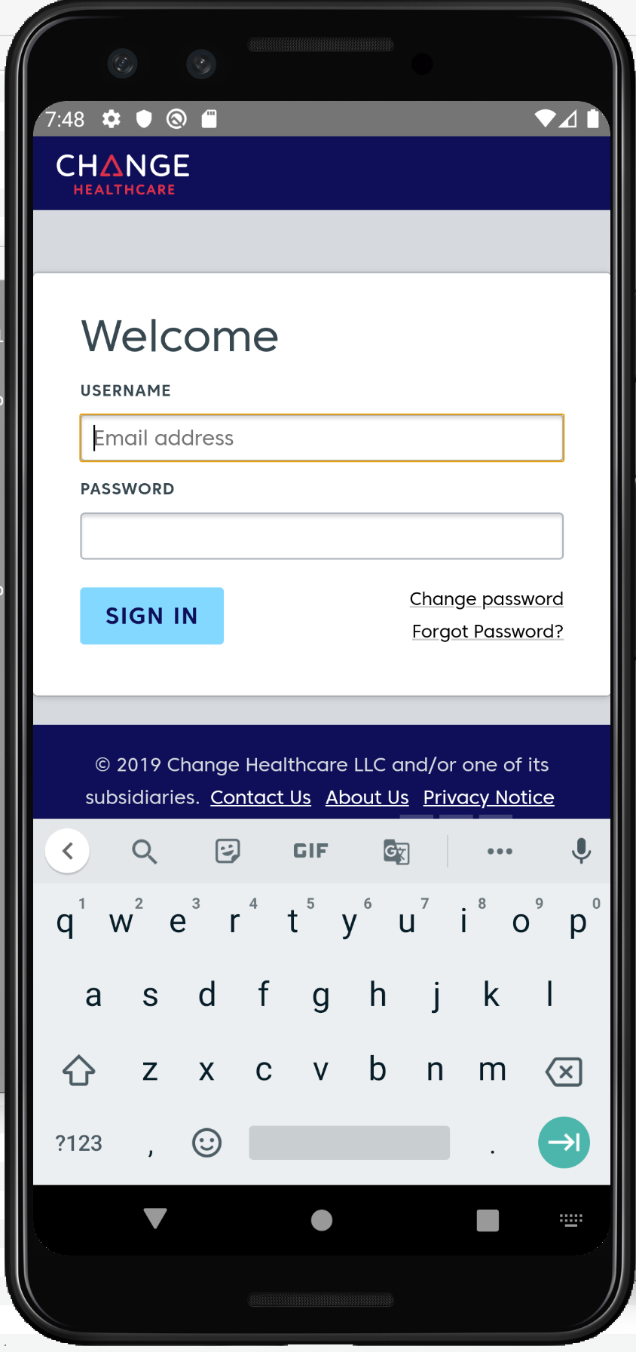
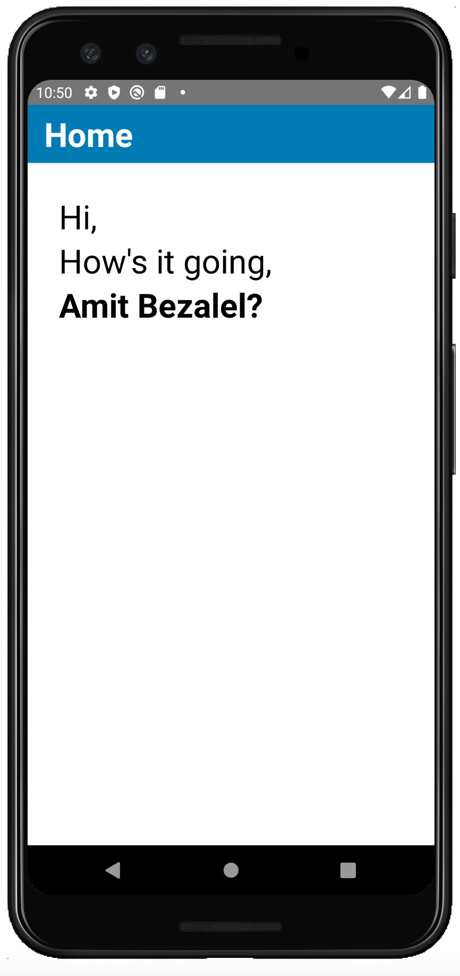
Env installation
For all that have done these in advance: (wiki instructions)
Download & install NodeJS 12
Download & install Java 11
Install & Launch Android studio
Create & Run a Device in Android Emulator
Download & Run the Demo CHC application

Slide 29
CHC App demo & Code overview

Slide 30

Questions
Questions?

